Slide 1


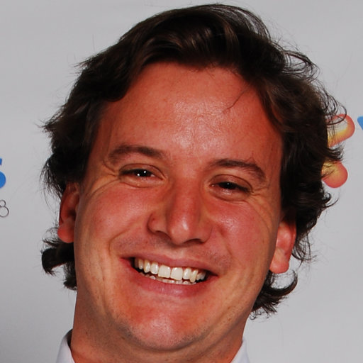
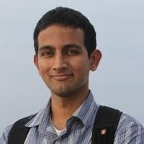
Formal Privacy: Making an Impact at Large Organizations Topic Contributed Session sponsored by the ASA Privacy & Confidentiality Committee JSM 2019, Denver, CO Wed, July 31st, 2019 10:20 am – 12:20 pm
Panelists:
Simson Garfinkel
US Census Bureau
Ilya Mironov
Google/Facebook
Juan Lavista Ferres
Microsoft
Shiva Kasiviswanathan
Amazon
Organizer: Lars Vilhuber, Cornell University
Chair: Aleksandra (Sesa) Slavkovic (sesa@psu.edu), Penn State University

Slide 2
Key Questions
With heightened disclosure risks, current statistical disclosure methods are insufficient for data protection
Formal privacy guarantees - provable privacy guarantees that hold regardless of assumed knowledge and attack strategy of a malicious user - are becoming increasingly important for large producers of statistics
How is differential privacy (DP) implemented in your organization?
What are the key challenges?
How do you evaluate data quality – privacy — access tradeoffs?
Is DP accepted within your organization?
Is DP accepted by your clients/stakeholders?
What are the next steps?

